Slide 1
02 | Introduction to Probability
Cynthia Rudin | MIT Sloan School of Management

Slide 2
Probability
The most essential skill you need to make your case as a data scientist.
Notes:
*Read1* You don’t need a ton of probability, you just need a really solid grasp of the basics. That’s what I’m going to give you here.

Slide 3
Common Mistakes
Discussing probability without defining its random variable.
Confusing correlation with causation.
Assuming that because a hypothesis test failed that the null hypothesis must be true.
Notes:
I was to start by discussing the most common mistakes I see among people communicating with data. First, they discuss the notion of probability without ever actually defining what it means in that context. You have to define a random variable in order to talk about probabilities. The word probability by itself is sort of meaningless.
*Read 2* Correlation is not causation, they are quite different.
*read 3* Hypothesis testing should not be done by people who don’t know what hypothesis tests mean. We’re going to make sure you’re not one of those people.
Actually If you goof up any of these three things, people are not going to take you seriously. They’re going to think that you don’t know what you’re talking about. This happens all the time because data scientists, who are often computer scientists, don’t always have the training in statistics that they need. So I’m going to start this lecture by making sure you know the basics of probability. So I’ll start with random variables.

Slide 4
What is a Random Variable?
A random variable assigns a numerical value to each possible outcome of a random experiment.
Are these random variables?
Today’s weather
The number of millimeters of rainfall tomorrow in Redmond
The color of a car chosen at random
1 if the next car we see is blue, 2 if it’s green, 4 if black…
The result of a coin flip (heads or tails)
For a coin flip, assign 1 if heads, 0 if tails
The price of Microsoft stock
The number of laps between yellow flags in an F1 race
Notes:
*read definition* Again, it’s something whose value depends on chance. It has to have a *numerical* value.
The color of a car chosen at random is not a random variable, but it would be if you assigned a number to each color.
*read*
if they say “today’s weather”, say something like “the number of inches of rainfall between 1-5 pm”
price of microsoft stock – not yesterday’s price, tomorrow’s price.
- number of laps between yellow flags in a nascar race

Slide 5
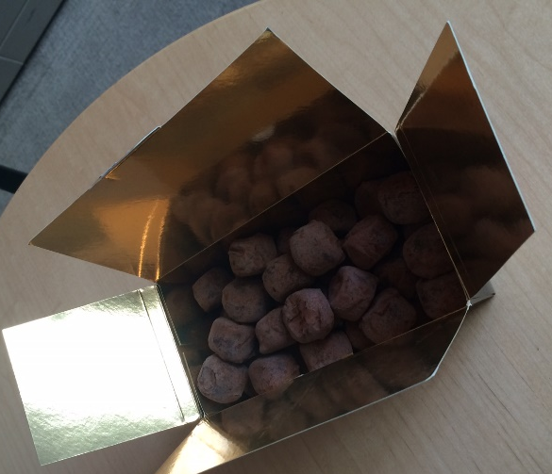
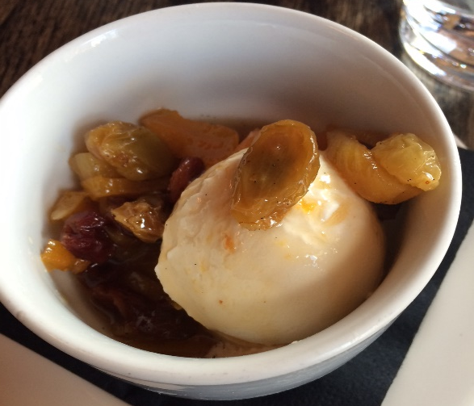
Varieties of Random Variables
Discrete
The number of truffles in a box
Continuous
The amount of ice cream I will eat today
Notes:
Truffles, cheerios, peanuts, I assume the machines aren’t so consistent that they do it the same way every time, so it’s a random variable.
That’s a raisin on top of that ice cream – I got compote on top

Slide 6
02 | Discrete Random Variables

Slide 7

Discrete Random Variables: Roll of a Die
Outcome x | Probability p | P(X=x)=p
1 | 1/6 | P(X=1) = 1/6
2 | 1/6 | P(X=2) = 1/6
3 | 1/6 | P(X=3) = 1/6
4 | 1/6 | P(X=4) = 1/6
5 | 1/6 | P(X=5) = 1/6
6 | 1/6 | P(X=6) = 1/6
X: random variable, the value on the die when you roll it.
x: an outcome, either 1, 2, 3, 4, 5 or 6.
P(X=x) the probability that X will have outcome x. The probabilities must sum to 1.

Slide 8
Discrete Random Variables: Roll of a Die
Outcome x | Probability p | P(X=x)=p
1 | 1/6 | P(X=1) = 1/6
2 | 1/6 | P(X=2) = 1/6
3 | 1/6 | P(X=3) = 1/6
4 | 1/6 | P(X=4) = 1/6
5 | 1/6 | P(X=5) = 1/6
6 | 1/6 | P(X=6) = 1/6
This is the probability mass function for this random variable.

Slide 9
Discrete Random Variables: Roll of a Die
Outcome x | Probability p | P(X=x)=p
10 | 1/6 | P(X=10) = 1/6
20 | 3/12 | P(X=20) = 3/12
30 | 1/12 | P(X=30) = 1/12
40 | 1/6 | P(X=40) = 1/6
50 | 1/6 | P(X=50) = 1/6
60 | 1/6 | P(X=60) = 1/6
X: random variable, the value on the die when you roll it.
x: an outcome, either 10, 20, 30, 40, 50 or 60.
P(X=x) the probability that X will have outcome x. The probabilities must sum to 1.

Slide 10
Discrete Random Variables: Roll of a Die
Outcome x | Probability p | P(X=x)=p
x₁ | p₁ | P(X=x₁) = p₁
x₂ | p₂ | P(X=x₂) = p₂
x₃ | p₃ | P(X=x₃) = p₃
x₄ | p₄ | :
: | : | :
x_{n} | p_{n} | P(X=x_{n}) = p_{n}
X: random variable, the value on the die when you roll it.
x: an outcome, either x₁, x₂, x₃, x₄,…,x_{n}.
P(X=x) the probability that X will have outcome x. The probabilities must sum to 1.

Slide 11
Summarizing Distributions
How would you compute the mean?
How would you measure the spread?

Slide 12
Computing the Mean
Outcome x | Probability p
10 | 1/6
20 | 1/6
30 | 1/6
40 | 1/6
50 | 1/6
60 | 1/6
How do you compute the mean?
Notes:
What’s the average outcome you should expect to get when rolling this over and over again?

Slide 13
Computing the Mean
Outcome x | Probability p
10 | 1/6
20 | 3/12
30 | 1/12
40 | 1/6
50 | 1/6
60 | 1/6
How do you compute the mean?
Notes:
What’s the average outcome you should expect to get when rolling this over and over again?

Slide 14
Computing the Mean
Outcome x | Probability p
0 | .03
1 | .14
2 | .35
3 | .32
4 | .15
5 | .01
Notes:
More practice
width=1.5;
set(0,'DefaultAxesLineWidth',width);
set(0,'DefaultLineLineWidth',width);
get(0,'Default');
set(gca,'LineWidth', width);
% make lines within a plot thicker
width=2
h = get(gca,'children');
set(h,'LineWidth', width);
% change font size
set(gca, 'Fontsize',20);
% if you want to have the x label and y label in bigger font you have to reissue the command to write those labels
xlabel('x')
ylabel('')
%ylabel('{\itAe}^{-\alpha\itt}sin\beta{\itt} \alpha<<\beta')

Slide 15
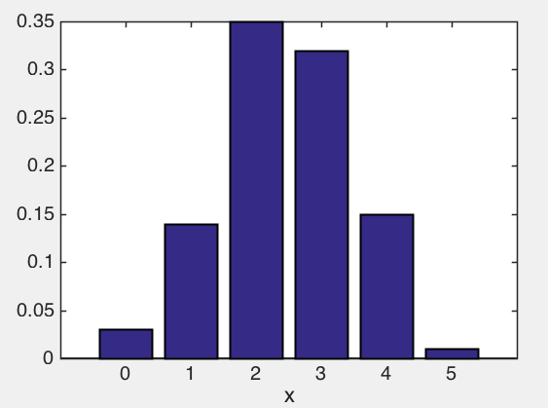
Computing the Mean
Outcome x | Probability p
0 | .03
1 | .14
2 | .35
3 | .32
4 | .15
5 | .01
Probability
Notes:
PMF
More practice
width=1.5;
set(0,'DefaultAxesLineWidth',width);
set(0,'DefaultLineLineWidth',width);
get(0,'Default');
set(gca,'LineWidth', width);
% make lines within a plot thicker
width=2
h = get(gca,'children');
set(h,'LineWidth', width);
% change font size
set(gca, 'Fontsize',20);
% if you want to have the x label and y label in bigger font you have to reissue the command to write those labels
xlabel('x')
ylabel('')
%ylabel('{\itAe}^{-\alpha\itt}sin\beta{\itt} \alpha<<\beta')

Slide 16
Computing the Mean
Outcome x | Probability p
0 | .03
1 | .14
2 | .35
3 | .32
4 | .15
5 | .01
Notes:
More practice

Slide 17
Computing the Mean
Notes:
*The mean is also called the expectation by the way, or expected value*. I’m going to use both notations throughout, so just remember that they stand for the same thing.

Slide 18
Computing the Spread
Outcome x | Probability p
0 | .03
1 | .14
2 | .35
3 | .32
4 | .15
5 | .01
Probability
Notes:
It’s a good guess but it’s not quite that it’s something only a little bit different.

Slide 19
Computing the Spread
Outcome x | Probability p
0 | .03
1 | .14
2 | .35
3 | .32
4 | .15
5 | .01
Probability
How might you compute the spread?
Sum of absolute differences from the mean?
Notes:
It’s a good guess but it’s not quite that it’s something only a little bit different.

Slide 20
Computing the Spread
Outcome x | Probability p
0 | .03
1 | .14
2 | .35
3 | .32
4 | .15
5 | .01
Probability
How might you compute the spread?
Sum of squared differences from the mean
Notes:
It’s a good guess but it’s not quite that it’s something only a little bit different.
But you’ve got good intuition on this other formula, so you should keep that.

Slide 21
Computing the Spread
Outcome x | Probability p
0 | .03
1 | .14
2 | .35
3 | .32
4 | .15
5 | .01
Probability
Notes:
The problem with the variance is it’s not in units that make any sense. If the outcomes are in dollars, then the variance is in dollars squared, so it doesn’t make much sense.
*click, Read std*
The standard deviation is in units that make sense, it’s back in dollars again.

Slide 22
Computing the Spread
Outcome x | Probability p
0 | .03
1 | .14
2 | .35
3 | .32
4 | .15
5 | .01
Probability
Notes:
The problem with the variance is it’s not in units that make any sense. If the outcomes are in dollars, then the variance is in dollars squared, so it doesn’t make much sense.
*click, Read std*
The standard deviation is in units that make sense, it’s back in dollars again.

Slide 23
Computing the Spread
Outcome x | Probability p
0 | .03
1 | .14
2 | .35
3 | .32
4 | .15
5 | .01
Probability
Notes:
The problem with the variance is it’s not in units that make any sense. If the outcomes are in dollars, then the variance is in dollars squared, so it doesn’t make much sense.
*click, Read std*
The standard deviation is in units that make sense, it’s back in dollars again.

Slide 24
02 | Some Special Discrete Probability Distributions: Bernoulli and Binomial

Slide 25
Bernoulli
Think of a coin flip.
Example: Each American has a 89% having health insurance.
1 if they have health insurance, 0 otherwise
X~Bernoulli(.89)
Outcome x | Probability p
1 | p
0 | 1-p

Slide 26
Binomial Distribution
Governs repeated Bernoulli trials, each with the same probability of success.
Notes:
So I told you before that the binomial distribution is governed by repeated trials, each with the same probability of success. The binomial distribution tells you how often you’ll get 0 successes, 1 success, 2 successes, and so on.

Slide 27
Many Bernoullis
Pick 10 Americans at random.
Let X = number of them without health insurance
What is P(X=3)?
1. Of 10 randomly chosen Americans, what is the probability that the first 8 will have heath insurance and the next 2 won’t?
2. What is the probability that the first 3 will have health insurance and the next 7 won’t?

Slide 28
Many Bernoullis
Pick 10 Americans at random.
Let X = number of them without health insurance
What is P(X=4)?
1. Of 10 randomly chosen Americans, what is the probability that the first 8 will have heath insurance and the next 2 won’t?
2. What is the probability that the first 3 will have health insurance and the next 7 won’t?
P(YYYYYYYYNN) = (.89)⁸*(.11)²

Slide 29
Many Bernoullis
Pick 10 Americans at random.
Let X = number of them without health insurance
What is P(X=4)?
2. What is the probability that the first 3 will have health insurance and the next 7 won’t?
2. What is the probability that the first 3 will have health insurance and the next 7 won’t?
P(YYYNNNNNNN) = (.89)³*(.11)⁷=1.37*10⁻⁷

Slide 30
Many Bernoullis
Pick 10 Americans at random.
Let X = number of them without health insurance
What is P(X=4)?
2. What is the probability that the first 3 will have health insurance and the next 7 won’t?
2. What is the probability that the first 3 will have health insurance and the next 7 won’t?
P(YYNYNNNNNN) = (.89)³*(.11)⁷=1.37*10⁻⁷

Slide 31
Many Bernoullis
Pick 10 Americans at random.
Let X = number of them without health insurance
What is P(X=4)?
2. What is the probability that the first 3 will have health insurance and the next 7 won’t?
2. What is the probability that the first 3 will have health insurance and the next 7 won’t?
P(NNNYNNNYNY) = (.89)³*(.11)⁷=1.37*10⁻⁷

Slide 32
Many Bernoullis
Pick 10 Americans at random.
Let X = number of them without health insurance
What is P(X=3)?
1. Of 10 randomly chosen Americans, what is the probability that the first 8 will have heath insurance and the next 2 won’t?
2. What is the probability that the first 3 will have health insurance and the next 7 won’t?
Need to add up all possibilities with X=3.
P(YYYNNNNNNN) + P(YYNYNNNNNN)+…
+... +.... +…..
All of these probabilities are 1.37*10^{-7,}….
but how many are there?
Notes:
It’s the number of ways I can choose 3 objects out of 10.

Slide 33
Choosing 3 out of 10
Suppose there are 10 data scientists seated in a row. How many ways to pick a group of 3?
How many ways to arrange them?
10! = 10*9*8*7*6*5*4*3*2*1
How many ways to arrange the 3 I pick?
3!
How many ways to arrange the 7 I didn’t pick?
7!
Notes:
How many ways are there to rearrange 10 numbers? There are 10 possibilities for the first number I pick, then 9 possibilities for the second number given the first one, and so on. So it’s the number of ways to rearrange 10 numbers divided by the number of ways to rearrange the 4 elements we chose, divided by the number of ways to rearrange the numbers we didn’t choose.

Slide 34
Choosing 3 out of 10
Suppose there are 10 data scientists seated in a row. How many ways to pick a group of 3?
More generally, n choose k:
Notes:
The total number of ways to arrange the scientists divided by the number of ways to arrange the 3 I picked, and also divided by the number of ways to arrange the 7 I didn’t pick.

Slide 35
Many Bernoullis
Pick 10 Americans at random.
Let X = number of them without health insurance
What is P(X=3)?
1. Of 10 randomly chosen Americans, what is the probability that the first 8 will have heath insurance and the next 2 won’t?
2. What is the probability that the first 3 will have health insurance and the next 7 won’t?
P(YYYNNNNNNN) + P(YYNYNNNNNN)+…
+... +.... +…..
All of these probabilities are 1.37*10^{-7,}….
but how many are there?
P(X=3)=120*(1.37*10⁻⁷)
Notes:
It’s the number of ways I can choose 3 objects out of 10.

Slide 36
Many Bernoullis
Pick 10 Americans at random.
Let X = number of them without health insurance
What is P(X=3)?
1. Of 10 randomly chosen Americans, what is the probability that the first 8 will have heath insurance and the next 2 won’t?
2. What is the probability that the first 3 will have health insurance and the next 7 won’t?
Notes:
It’s the number of ways I can choose 3 objects out of 10.
n is the total number of yes/no questions, which is 10 here because we have 10 americans who can either say yes or no
X is the number of yes’s I get out of those 10,
P is the probability that they will say yes or no.

Slide 37
Binomial Distribution
Pick n Americans at random.
Each has probability p of having insurance
Let X = number of them without health insurance
What is P(X=x)?
1. Of 10 randomly chosen Americans, what is the probability that the first 8 will have heath insurance and the next 2 won’t?
2. What is the probability that the first 3 will have health insurance and the next 7 won’t?
Notes:
It’s the number of ways I can choose 3 objects out of 10.
n is the total number of yes/no questions, which is 10 here because we have 10 americans who can either say yes or no
X is the number of yes’s I get out of those 10,
P is the probability that they will say yes or no.
So I told you before that the binomial distribution is governed by repeated trials, each with the same probability of success. The binomial distribution tells you how often you’ll get 0 successes, 1 success, 2 successes, and so on. That’s exactly what we just computed.

Slide 38
Binomial Distribution
n independent trials
Each has probability p of success
Probability of x successes out of n is:
1. Of 10 randomly cosen Americans, what is the probability that the first 8 will have heath insurance and the next 2 won’t?
2. What is the probabil the next 7 won’t?
Notes:
It’s the number of ways I can choose 3 objects out of 10.
n is the total number of yes/no questions, which is 10 here because we have 10 americans who can either say yes or no
X is the number of yes’s I get out of those 10,
P is the probability that they will say yes or no.
So I told you before that the binomial distribution is governed by repeated trials, each with the same probability of success. The binomial distribution tells you how often you’ll get 0 successes, 1 success, 2 successes, and so on. That’s exactly what we just computed.

Slide 39
Binomial Distribution
Flip 20 coins at random.
Each has probability .5 of landing heads
Let X = number of them with heads
What is P(X=10)?
1. Of 10 randomly chosen Americans, what is the probability that the first 8 will have heath insurance and the next 2 won’t?
2. What is the probability that the first 3 will have health insurance and the next 7 won’t?
Notes:
It’s the number of ways I can choose 3 objects out of 10.
n is the total number of yes/no questions, which is 10 here because we have 10 americans who can either say yes or no
X is the number of yes’s I get out of those 10,
P is the probability that they will say yes or no.
So I told you before that the binomial distribution is governed by repeated trials, each with the same probability of success. The binomial distribution tells you how often you’ll get 0 successes, 1 success, 2 successes, and so on. That’s exactly what we just computed.

Slide 40
Binomial Distribution Example
Flip 20 coins at random.
Each has probability .5 of landing heads
Let X = number of them with heads
What is P(X≤10)?
1. Of 10 randomly chosen Americans, what is the probability that the first 8 will have heath insurance and the next 2 won’t?
2. What is the probability that the first 3 will have health insurance and the next 7 won’t?

Slide 41
Binomial Distribution Example
Flip 20 coins at random.
Each has probability .5 of landing heads
Let X = number of them with heads
What is P(X=x) for any x between 0 and 20?
1. Of 10 randomly chosen Americans, what is the probability that the first 8 will have heath insurance and the next 2 won’t?
2. What is the probability that the first 3 will have health insurance and the next 7 won’t?

Slide 42
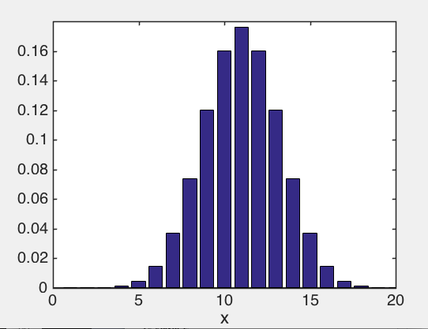
Binomial Distribution Example
Flip 20 coins at random.
Each has probability .5 of landing heads
Let X = number of them with heads
What is P(X=x) for any x between 0 and 20?
1. Of 10 randomly chosen Americans, what is the probability that the first 8 will have heath insurance and the next 2 won’t?
2. What is the probability that the first 3 will have health insurance and the next 7 won’t?
Probability
Binomial PMF
Notes:
Remember what that looks like – a bump. We’ll get back to that later.
Again the mean is np the variance in np(1-p) and obviously the std is the square root of the variance.

Slide 43
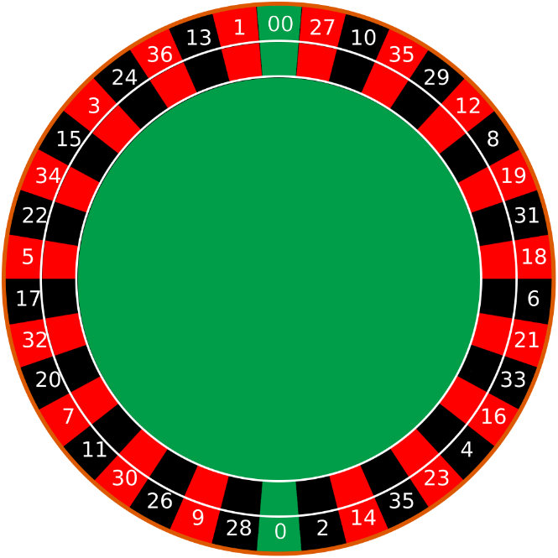
Anyone for Roulette?
18 black, 18 red, 2 green
Bet on black 10 times, what is the chance to win at least 4?
Notes:
One of the most popular casino games, very glamorous. All based on the idea of independent random trials.
The ball rolls and lands in one of the slots and you can bet on a either a number or a color.
Let’s say we make a bet on black, meaning that when we spin the wheel, the little ball lands in a black bin.
Roulette is based on independent events, because the assumption is that you start fresh every time you play. Gamblers use the expected value to tell them how well they will do over a series of fixed bets. Let’s calculate the expected value of a black bet.

Slide 44
Anyone for Roulette?
18 black, 18 red, 2 green
Bet on black 10 times, what is the chance to win at least 4?
Notes:
One of the most popular casino games, very glamorous. All based on the idea of independent random trials.
The ball rolls and lands in one of the slots and you can bet on a either a number or a color.
Let’s say we make a bet on black, meaning that when we spin the wheel, the little ball lands in a black bin.
Roulette is based on independent events, because the assumption is that you start fresh every time you play. Gamblers use the expected value to tell them how well they will do over a series of fixed bets. Let’s calculate the expected value of a black bet.

Slide 45
02 | Some Special Discrete Probability Distributions: Poisson

Slide 46
Poisson Distribution
The Poisson distribution is a limiting version of the Binomial distribution, when
Notes:
For rare events. A famous example of the Poisson distribution
A practical application of this distribution was made by Ladislaus Bortkiewicz in 1898 when he was given the task of investigating the number of soldiers in the Prussian army killed accidentally by horse kicks;

Slide 47
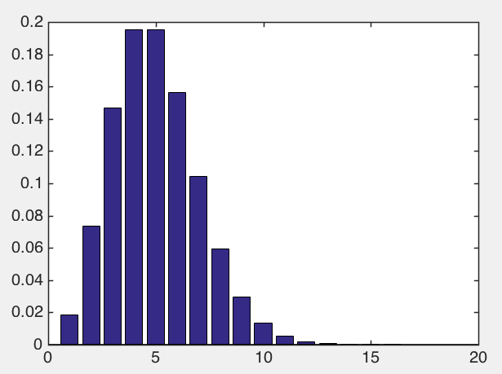
Poisson Distribution
The Poisson distribution is a limiting version of the Binomial distribution, when
Probability
Notes:
For rare events. The neat thing about the Poisson distribution is that they knew about it over 100 years before they found a really good example of it in real life. The real life example was the
Here’s the pmf. Looks like a shifted version of the binomial bump, which it should, given that it’s a limiting distribution of the binomial.

Slide 48
Poisson Distribution
The Poisson distribution is a limiting version of the Binomial distribution, when
Useful for modeling waiting times for independent events.
Probability
Notes:
For rare events. The neat thing about the Poisson distribution is that they knew about it over 100 years before they found a really good example of it in real life. The real life example was the
Here’s the pmf. Looks like a shifted version of the binomial bump, which it should, given that it’s a limiting distribution of the binomial.

Slide 49
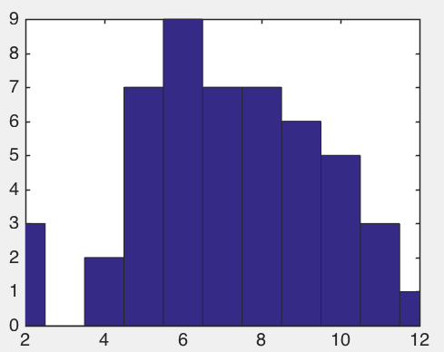
Poisson Distribution
Cynthia gets about 7 emails per hour
7 emails per hour
Count within hour
Notes:
This is the number of emails that require a response.
Kept track of the number of emails I got for

Slide 50
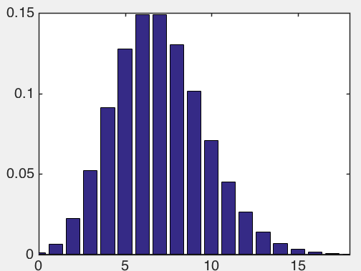
Poisson Distribution
Cynthia gets about 7 emails per hour
7 emails per hour
Count within hour
Notes:
For rare events. The neat thing about the Poisson distribution is that they knew about it over 100 years before they found a really good example of it in real life. The real life example was the
Here’s the pmf. Looks like a shifted version of the binomial bump, which it should, given that it’s a limiting distribution of the binomial.

Slide 51
02 | Continuous Probability Distributions

Slide 52
Continuous Probability Distributions
Outcome x | Probability p
0 | .03
1 | .14
2 | .35
3 | .32
4 | .15
5 | .01
This does not work. Why not?

Slide 53
content
Bullet---------------------------------------------------------
Notes:
The total number of ways to arrange the scientists divided by the number of ways to arrange the 3 I picked, and also divided by the number of ways to arrange the 7 I didn’t pick.

Slide 54

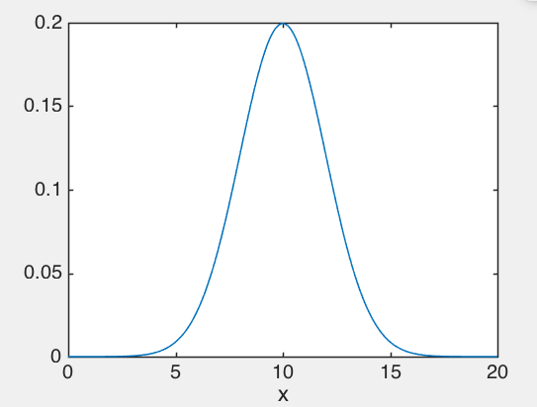

Continuous Probability Distributions
This is a distribution of how much coffee Steve Elston will consume in liters over the next week.
Notes:
The higher the curve is, the more likely the value is. So Steve is more likely to consume around 10 liters than around 15 or 5 liters. But the probability that he’ll consume any particular exact amount of coffee is exactly 0. So it no longer makes sense to say that the probability that he’ll consume 8.253 liters of coffee is .1, that makes no sense. The probability is 0. It makes much more sense to what is the probability that he will consume between 10 and 15 liters, and that’s this much.

Slide 55
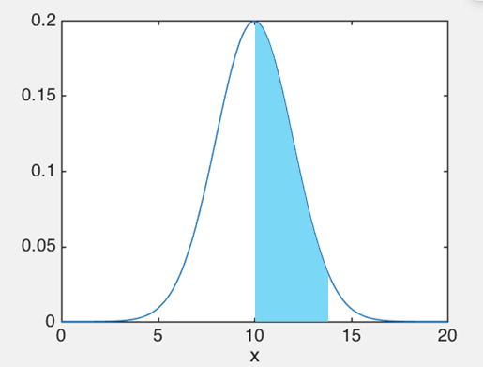
Continuous Probability Distributions
Notes:
The shaded area is the *area* under this curve. If I try to ask what’s the probability to land on a particular value, the area under that single value will be 0, but if I look at a range of values, it won’t be 0!

Slide 56
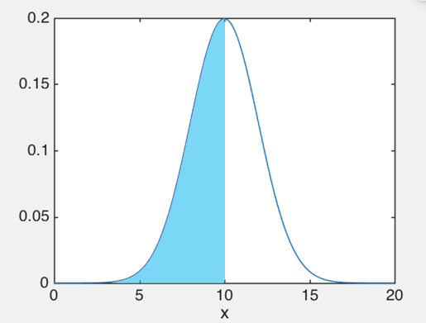
Continuous Probability Distributions
Notes:
Or you could say what’s the probability he’ll have less than 10 liters? And that’s about a 50% probability.

Slide 57
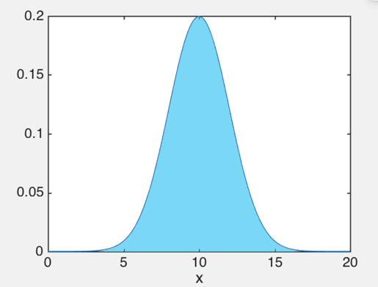
Continuous Probability Distributions
Notes:
Now you could say “what’s the probability he’ll have less than 20 liters? Looks like he pretty much always has less than 20 liters, so that probability is about 1. And the total area under there had really better be 1 because that’s the largest possible probability you can ever get.

Slide 58
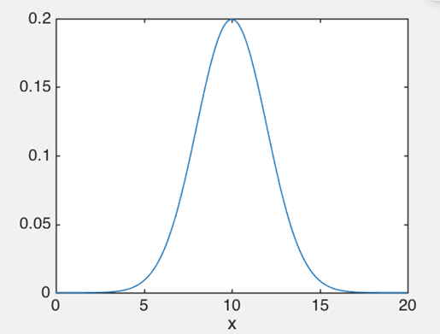
Continuous Probability Distributions
This is called a probability density function (pdf).
Notes:
It integrates to 1, areas under it are probabilities.

Slide 59
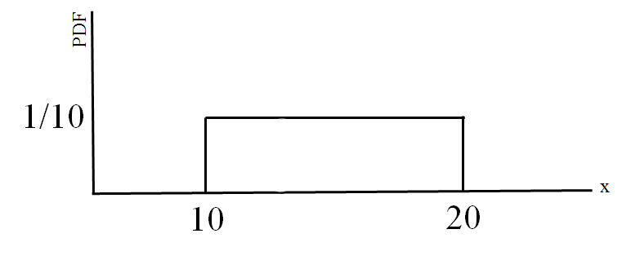
Continuous Probability Distributions
This the pdf for the uniform distribution.
Notes:
It doesn’t have to look like that, it can look like 2 bumps or flat or whatever. It just has to integrate to 1.

Slide 60
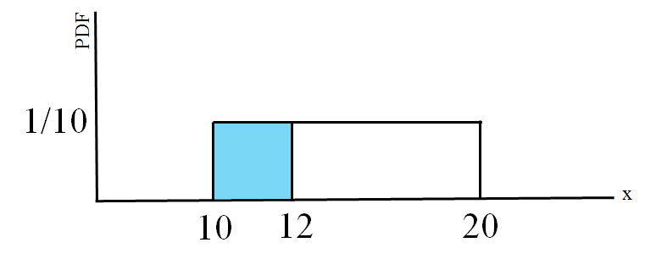
Continuous Probability Distributions
Notes:
Here’s a probability for you. Then the area under here is .2 (2 wide by 1/10th high).

Slide 61
Continuous Probability Distributions
Notes:
Back to this. How do we calculate these things?

Slide 62
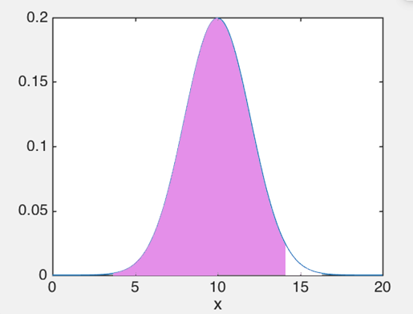
Continuous Probability Distributions
Notes:
We usually do it by subtracting two quantities. This one, and I will then subtract this one

Slide 63
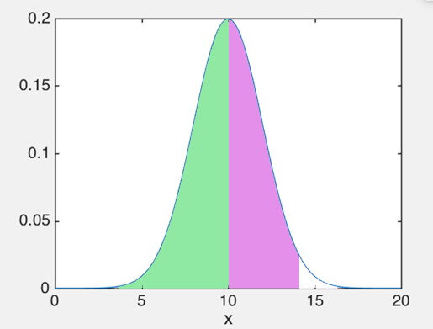
Continuous Probability Distributions
Notes:
This one, and I get the probability I want, which is just the thing in pink.
This brings me to the discussion of CDF’s, or cumulative distribution functions.

Slide 64
02 | Cumulative Distribution Functions

Slide 65
Cumulative Distribution Functions
PDF
Coffee (liters)
Notes:
The cumulative distribution function tells you the probability for X to be below a specific value. In our case it’s 14. The cumulative distribution function is written just like this, F(14) is the probability of the random variable to take on a value below 14.
I can write it more generally.

Slide 66
Cumulative Distribution Functions
PDF
Coffee (liters)
Notes:
For any amount of coffee x that Steve might drink, the CDF gives the probability to drink less than that value.
Does it matter whether I write less than or equal to or just less than?

Slide 67
Cumulative Distribution Functions
PDF
Coffee (liters)
Notes:
For any amount of coffee x that Steve might drink, the CDF gives the probability to drink less than that value.
Does it matter whether I write less than or equal to or just less than? Nope doesn’t matter, because the probability he’ll drink exactly that value down to the molecule, is 0. For continuous distributions they are the same.

Slide 68
Cumulative Distribution Functions
PDF
Notes:
So this subtraction can actually be written in terms of the CDF’s

Slide 69
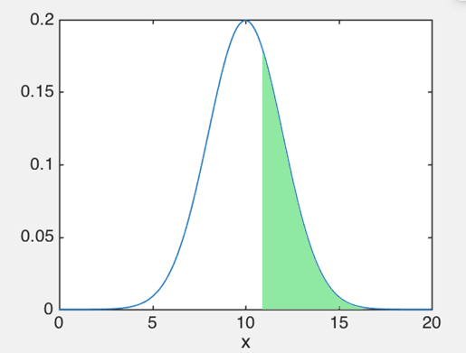
Cumulative Distribution Functions
PDF
Notes:
So this subtraction can actually be written in terms of the CDF’s

Slide 70
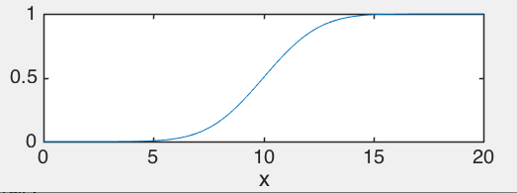
Cumulative Distribution Functions
PDF
F(x)
Notes:
What’s the smallest value of the CDF? 0, all the way on the left.
Now you see I seem to be drawing bumps very often as my example of what a pdf ought to look like, which means the CDF looks kind of like this function down here. There is a very good reason I keep drawing bell curves like this, and I will tell you what it is. It is called the central limit theorem, and that’s up next.

Slide 71
02 | Central Limit Theorem and the Normal Distribution

Slide 72
$
$
$
$
How much total do they spend at the store?
Store
Notes:
Every day, the

Slide 73
$
$
$
$
How much total do they spend at the store?
Store
Notes:
Every day, the

Slide 74
$
$
$
$
How much total do they spend at the store?
Store
Notes:
Haha maybe we have some students from the class taking their computers to the store while they are learning data science. Each of them has their own distribution of how much they spend. *pause* Every evening, the store counts their total profit. Every day it’s slightly different than it was the day before. We ask the store to plot the distribution of its profits.

Slide 75
$
$
$
$
Store

Slide 76
$
$
$
$
Store
Sum of customers’ means

Slide 77
Notes:
Now start over

Slide 78
$
Store
Notes:
This is a totally different store, with totally different customers.

Slide 79
$
Store
Notes:
In fact, it’s on the other side of the world. Everything is different. Now we ask, what is the distribution of this store’s profits?

Slide 80
Notes:
Rather interestingly

Slide 81
Notes:
Ha ha ha! They also end up with a very similar looking sort of bump. Totally different store, totally different customers, and yet still, a single bump, with the same shape. The mean has the formula same too *switch*

Slide 82
Sum of customers’ means
Notes:
it’s the sum of means of the customers individual means.

Slide 83
Notes:
So what is going on here. Turns out, and get this - it always happens. The same bump.

Slide 84
The Normal Distribution
Notes:
This is called the normal distribution. It’s shape is given by this particular formula. It’s always the same formula, always the same shape. The formula has the mean in it, mu, and it has the standard deviation sigma. Just to remind you, the mean is the center of the distribution, and the standard deviation sigma is a measure of the spread of the distribution. Now… if you know those two things, that completely determines the shape of the curve. And it always integrates to 1. Funny things happen when you fiddle with the mean and variance.

Slide 85
The Normal Distribution
Notes:
You could get very peaky normal distributions with small standard deviations, or very broad ones, with large stds. And the mean can be whatever it wants

Slide 86
The Central Limit Theorem
The sum of a large number of independent random variables is approximately normal.
Notes:
Now the cool thing is this fact that I told you. This is actually called *click*
And it’s one of the most famous theorems in the world. *repeat*. So even though each of those customers had a totally different distribution, when you add them up, the result is normal.
Take their sum,
And it has an approximately normal distribution. The mean is the sum of the means of the individual variables. The variance turns out to be the sum of the variances. Of course the std is the sqrt of the variance.
The larger n is then the closer to normal S_n is.
As it turns out that if the Xn’s are normal in the first place, then their sum is exactly normal anyway. If you start out with weird distributions, then n needs to be a bit bigger to look normal.

Slide 87
Notes:
Because of the central limit theorem, this distribution pops up all the time. This formula is not something a person made up, it’s something that exists in nature. It’s just as natural as the patterns you might find looking at water waves or seashells, it’s something that comes with the earth. It’s the distribution of the amount of rain in Boston over a year, it’s the distribution of test grades (assuming no systematic cheating), and it’s the distribution of anything that is a sum of independent events. It’s like E=mc^2 for probability.

Slide 88
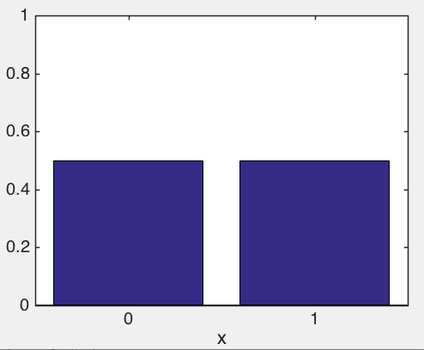
Back to the Binomial
Doesn’t the binomial come from a sum of independent random variables?
n=1, p=.5
Notes:
This is not just true for stores.
The limiting binomial is a normal. Isn’t that lovely?

Slide 89
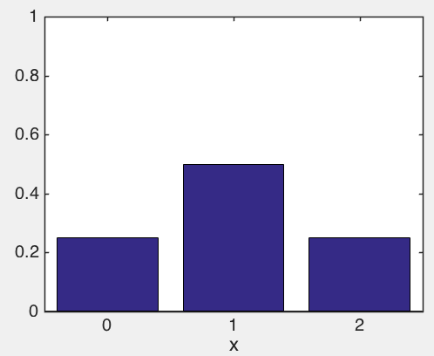
Back to the Binomial
Doesn’t the binomial come from a sum of independent random variables?
n=2, p=.5
Notes:
The limiting binomial is a normal. Isn’t that lovely?

Slide 90
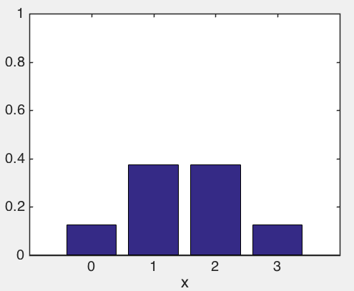
Back to the Binomial
Doesn’t the binomial come from a sum of independent random variables?
n=3, p=.5
Notes:
The limiting binomial is a normal. Isn’t that lovely?

Slide 91
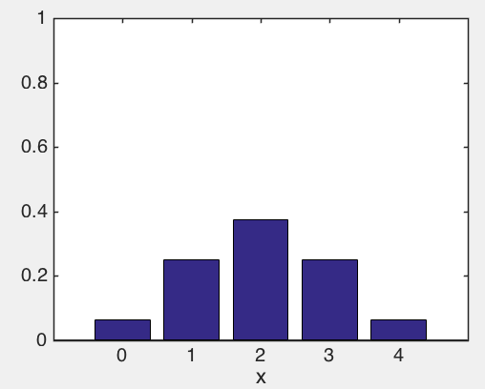
Back to the Binomial
Doesn’t the binomial come from a sum of independent random variables?
n=4, p=.5
Notes:
The limiting binomial is a normal. Isn’t that lovely?

Slide 92
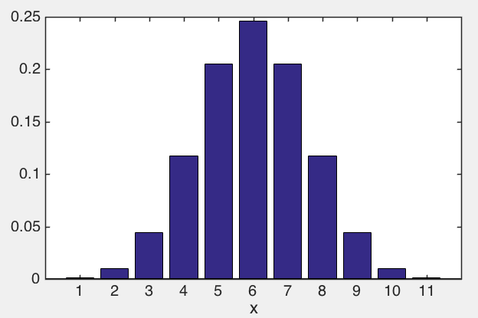
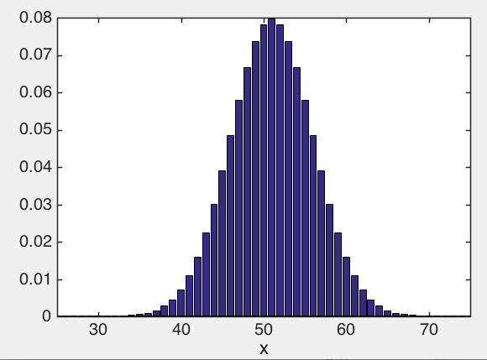
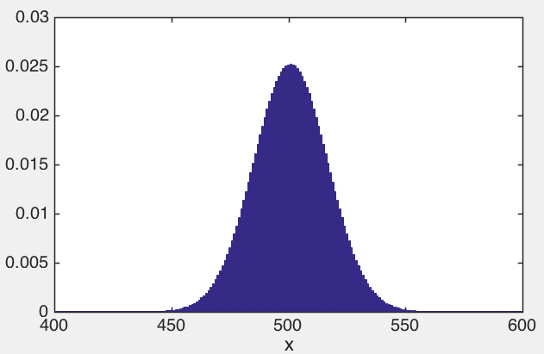
Back to the Binomial
Doesn’t the binomial come from a sum of independent random variables?
n=10, p=.5
n=100, p=.5
n=1000, p=.5
Notes:
The limiting binomial is a normal. Isn’t that lovely?

Slide 93
Back to the Binomial
For large n, the binomial distribution becomes the normal distribution.

Slide 94
02 | Descriptive Statistics and Visualization
Cynthia Rudin | MIT Sloan School of Management

Slide 95
The most useful command is…
Notes:
There is a single command that I issue more than any other command when I’m exploring data. This single command makes my favorite and most useful sort of plot of all time. And that plot is…

Slide 96
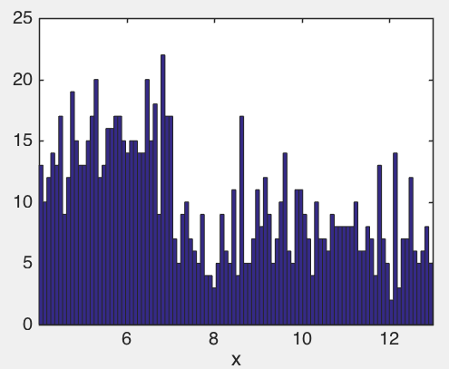
Histogram
X
8.3
5.2
9.1
10.3
5.9
6.8
:
probability
Notes:
They approximate the pdf of a random variable. If you have a pile of numbers, the first thing you should do is look at it. This is how you do it. You can do this with one line of code in almost any software, and it’ll create equal size bins, and plop your data into them, telling you how many points are in each bin. Boom that’s a histogram. So this is telling you for instance, that there are 23 numbers in your dataset between values 6.86 and 6.95 or whatever.

Slide 97
Bar Chart
Good for summarizing data within categories.
probability
bike
car
train
bus
categories

Slide 98
Pareto Chart
Good for summarizing data within categories.
probability
train
bike
car
bus
categories
Notes:
Plots are how you’re going to tell stories as a data scientist – these are the building blocks of your story – the words if you like.

Slide 99
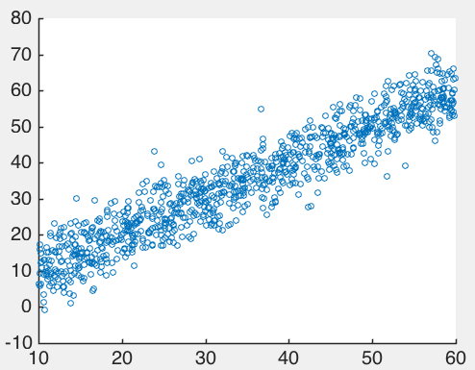
Scatter Plots
Ads Budget | Sales
40 | 43
15 | 18
27 | 24
35 | 38
10 | 8
17 | 14
: | :
Sales
Ads Budget

Slide 100
Scatter Plots
Ads Budget | Sales
40 | 43
15 | 18
27 | 24
35 | 38
10 | 8
17 | 14
: | :
(40,43)
Sales
Ads Budget

Slide 101
Notes:
There’s a break here for Steve’s case study

Slide 102
Summary Statistics

Slide 103
Summary Statistics
Sample Mean
Quantiles/Percentiles – Order the data. Then find so that it divides the data into two parts where:
A fraction p of the data values are less than or equal to
and:
The remaining fraction (1-p) are greater than .
Sample Median – the middle value of the x_{i}’s.
Notes:
Do not confuse x bar with mu. Usually we write mu as the mean of the whole distribution, whereas xbar is the average of the points we draw from the distribution. Be careful – everything in these slides are quantities we compute from a sample of the data. These are not the same computations that we would do if we knew the underlying population. Here we don’t know the underlying population, we have only the data. So we can only use the data we have, not the whole population. As long as the sample is large enough, the sample mean (that we compute here) is going to be similar to the population mean.

Slide 104
Summary Statistics
Sample Mean
Quantiles/Percentiles – Order the data. Then find so that it divides the data into two parts where:
A fraction p of the data values are less than or equal to
and:
The remaining fraction (1-p) are greater than .
Sample Median – the middle value of the x_{i}’s.
Notes:
How do you compute quantiles/percentiles. You order the data. Then,

Slide 105
Summary Statistics
Sample Mean
Quantiles/Percentiles – Order the data. Then find so that it divides the data into two parts where:
A fraction p of the data values are less than or equal to
and:
The remaining fraction (1-p) are greater than .
Sample Median – the middle value of the x_{i}’s.
.55 quantile
-1.75 -0.89 -0.32 0.11 0.72 1.30 2.21 4.57 8.05

Slide 106
Summary Statistics
Sample Mean
Quantiles/Percentiles – Order the data. Then find so that it divides the data into two parts where:
A fraction p of the data values are less than or equal to
and:
The remaining fraction (1-p) are greater than .
Sample Median – the middle value of the x_{i}’s.
Notes:
Do not confuse x bar with mu. Usually we write mu as the mean of the whole distribution, whereas xbar is the average of the points we draw from the distribution.

Slide 107
Summary Statistics
Sample Variance
Notes:
I put up the formula for the sample variance here. There’s something strange going on here. This part you’d expect, right, because it’s sort of as the definition of the population variance, take each point, subtract something like a mean, and square it. But you’d think this would be a 1/n here, right? Surprise, it’s n-1.

Slide 108
Summary Statistics
Sample Variance
Some weirdness
Notes:
The reason for this is actually very technical. It has to do with bias – if we put a 1/n here, the sample variance would be what’s called a biased estimator of the true population variance. But you should not worry about this. Let the software do it for you. Every piece of software I have ever used had a command to compute the sample variance. You just give it the data and ask it for the variance and it will remember the 1/n-1 so you don’t have to.

Slide 109
Summary Statistics
Sample Variance
Sample Standard Deviation
Notes:
And then luckily the sample standard deviation is the same

Slide 110
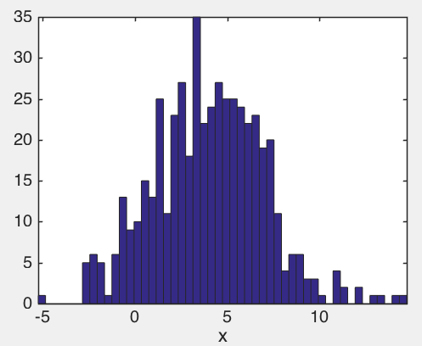
x =[ -1.7584 3.8907 0.3246 -1.7073 11.1227 3.3000 5.2116 7.5774 -1.0543,...., ]
Notes:
500 points, I made a histogram. I just want to summarize the important bits. I don’t want to preserve all of it

Slide 111
Five Number Summary
max 14.71
min -5.21
Q₃=6.01
Q₁=2.03
Q₂=4.02
Notes:
This is called the 5 number summary.

Slide 112
Range
max 14.71
min -5.21
Notes:
Range

Slide 113
Interquartile Range
Q₃=6.01
Q₁=2.03
Notes:
This is called the 5 number summary.

Slide 114
Summary Statistics
5 Number Summary

Slide 115
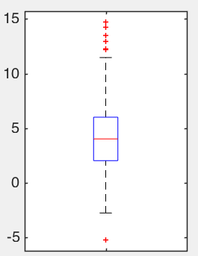
Box Plot
Notes:
If I’m ok with summarizing a distribution like this, then I can get away with plotting many distributions succinctly on the same page. Visually it’s easier for humans to understand. But how to get from the distribution to the boxplot is a little weird. Let me tell you about it.

Slide 116
Box Plot
Alternative to a histogram
Median, Q₂
Notes:
It’s the median, the middle number is in the middle. It’s not the mean, it’s the median. Strangely enough, the mean doesn’t usually get marked on a box plot, I’m not sure why not. Sometimes people mark it on there, which I think is a good idea. But just because I think it’s a good idea means that people who write visualization software think it’s a good idea.

Slide 117
Box Plot
Alternative to a histogram
Third quartile, Q₃
Median, Q₂
First quartile, Q₁
Notes:
Then the main box there just tells you where the quartiles are.
BTW don’t the word quartile messed up with the word quantile. Quartile sounds like quarter. There are only 4 quartiles, but an arbitrary number of quantiles.

Slide 118
Box Plot
Alternative to a histogram
Point just below
Q₃ + 1.5*IQR
Third quartile, Q₃
Median, Q₂
First quartile, Q₁
Notes:
The whiskers are more complicated.

Slide 119
Box Plot
Alternative to a histogram
Point just below
Q₃ + 1.5*IQR
Third quartile, Q₃
Median, Q₂
First quartile, Q₁
Point just above
Q₁ - 1.5*IQR
Notes:
.. And then any other point outside the whiskers gets marked with a plus. So the 5 number summary is there, you’ve got the min and max marked, and also the first second and third quartiles. The nice thing about these box plots is that you can visually understand the distribution very quickly. You don’t need all the little wiggles in the histogram to understand what’s going on, and yet you can still pack several boxplots into a figure to have many of them on the same screen because they are so compact.

Slide 120
02 | Z-scores, Percentiles of the Normal Distribution, Covariance, and Correlation
Cynthia Rudin | MIT Sloan School of Management
Notes:
This lecture is all about how to view data with respect to other data. If you tell me you’re an excellent salesman because you sold $100,000 worth of widgets, I have no idea what that means. You could be terrible compared to your peers, but how would I know that based on what you told me? If you tell me the zscore, or what percentile you were, then that’s a different story, that’s meaningful. And obviously correlation and covariance are about the relationships between two random variables. So let’s start.

Slide 121
Z-scores
The z-score tells you where a point is, relative to other points in the distribution.
It is the number of standard deviations above or below the mean.
Notes:
It’s helpful to think of values relative to other values within the same distribution

Slide 122
Z-scores
I sold 1200 units.
The mean number is 1000 units
The standard deviation is 100 units
Notes:
It’s helpful to think of values relative to other values within the same distribution. If I just tell you that I sold 1200 units, that doesn’t mean much. You have no idea how good of a salesman I am. Because you don’t have enough context. *click* what if I told you the mean was 1000 units? Still, that doesn’t tell you very much. You have no idea how unusual it is to go above 1200 units. Is that very unusual or is it just I was slightly above the mean? What you need also is the standard deviation. If I tell you it is 100 units, then you know I mean business. I’m selling two standard deviations above the mean.

Slide 123
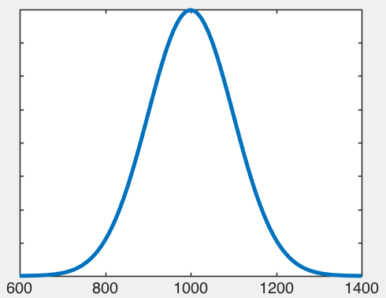
Z-scores
Frequency
Units sold
Notes:
The vast majority of other salespeople sell much less than 1200, I’m at the top of the pile if I’m up here.
And of course this picture assumes salespeople have an approximately normal distribution, which may or may not be true for a specific company but we’ll let it go for now.

Slide 124
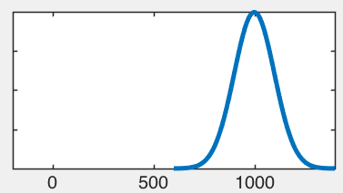
Z-scores
The z score of x is the number of standard deviations above or below the mean of X.
PDF of X

Slide 125
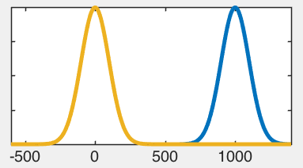
Z-scores
The z score of x is the number of standard deviations above or below the mean of X.
PDF of X-μ

Slide 126
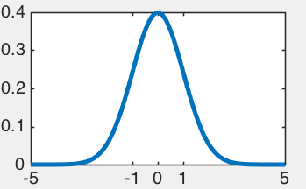
Z-scores
PDF of (X-μ)/σ
The z score of x is the number of standard deviations above or below the mean of X.

Slide 127
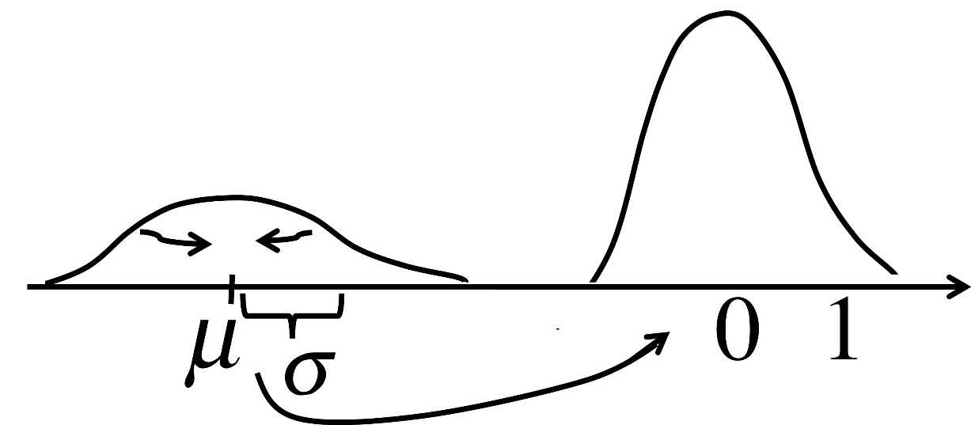
Z-scores
The z score of x is the number of standard deviations above or below the mean of X.

Slide 128
Sample z-scores
The sample z-score of x is the number of sample standard deviations above or below the sample mean.
Notes:
People often get confused an call these z scores (in fact I do that myself)

Slide 129
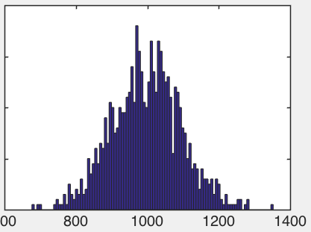
Sample z-scores
Frequency
Units sold
The sample z-score of x is the number of sample standard deviations above or below the sample mean.
Notes:
Even if I didn’t have the whole population, I might have the last few years of sales. It’s pretty clear that if I sold 1200 units, I’m pretty good. The t-statistic would tell me that I’m about two sample standard deviations above the mean. Just to give you some perspective, let me discuss for you how rare that actually is.

Slide 130
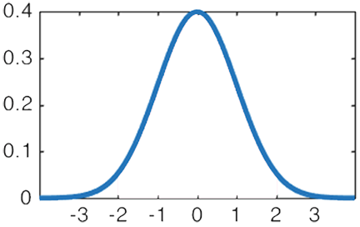
Percentiles of the Normal
Number of standard deviations

Slide 131
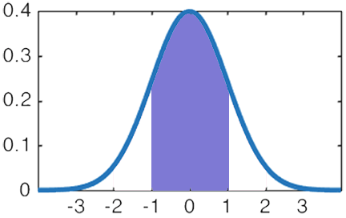
Percentiles of the Normal
68%
Number of standard deviations
Notes:
You can’t calculate this analytically by the way, you need a computer to do it.

Slide 132
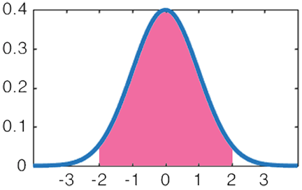
Percentiles of the Normal
95%
Number of standard deviations

Slide 133
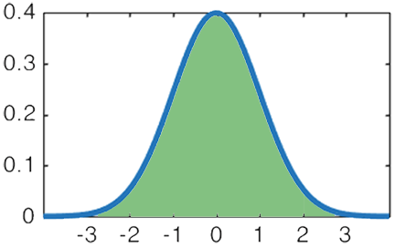
Percentiles of the Normal
99.7%
Number of standard deviations

Slide 134
Z-scores
2.5%
2.5%
95%
I sold 1200 units.
The mean number is 1000 units
The standard deviation is 100 units
Notes:
Now you can put it into context. *read* So I sold 2 standard deviations above the mean. The probability to be that extreme is only 2.5%, so I’m a pretty unusual salesperson.

Slide 135
02 | Covariance and Correlation

Slide 136
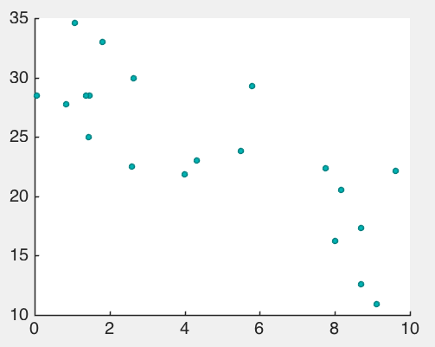
A Negative Correlation
Monster Bike Customers
Monster Scoot Customers
Notes:
There is a company that rents bikes and scooters to commuters. People get to choose either a bike or a scooter, whichever they want. As it turns out, there’s a negative correlation between the number of bike customers and the number of scoot customers. What does that actually mean? You can see a negative correlation in the scatter plot, clearly, but what is the technical definition of correlation? Well, let’s think about it this way.

Slide 137
A Negative Correlation
Monster Bike Customers
Monster Scoot Customers
Notes:
This is the average number of scoot customers per day and here’s the average number of bike customers.
If there are more than average scoot customers on a particular day, there are probably fewer than average bikes being rented that day.

Slide 138
A Negative Correlation
Higher than average Scoot corresponds to
Lower than average Bike
Monster Bike Customers
Monster Scoot Customers
Notes:
There it is.
And vice versa – if Monster Scoot has fewer customers than their usual average, it prolly means Monster Bike has a higher than average number of customers that day. This brings me to a formal definition of Covariance and correlation.

Slide 139

Covariance
Notes:
Let’s start with covariance. Let’s see whether X is above or below it’s mean. I’m writing the mean of X as E(X). I think I used the notation mu before, but the notation E(X) for expectation is just as common as the mu notation, so let’s use that. Ok so we look at whether X is above or below its mean.

Slide 140
Covariance
+
-
-
+
+ +
+ -
- +
- -
Notes:
Now let’s see if Y is above or below its mean.
If X is higher than its mean when Y is lower than its mean, this thing is going to be negative.

Slide 141
Covariance
+
-
-
+
+ +
+ -
- +
- -
Notes:
Now let’s see if Y is above or below its mean.
If X is higher than its mean when Y is lower than its mean, this thing is going to be negative.

Slide 142
Covariance
+
-
-
+
+ +
+ -
- +
- -
Notes:
Now let’s see if Y is above or below its mean.
If X is higher than its mean when Y is lower than its mean, this thing is going to be negative.

Slide 143
Covariance
+
-
-
+
+ +
+ -
- +
- -
Notes:
Now let’s see if Y is above or below its mean.
If X is higher than its mean when Y is lower than its mean, this thing is going to be negative.

Slide 144
Covariance

Slide 145
Sample Covariance

Slide 146
Sample Covariance
Notes:
What happens if you take the covariance of X with itself?

Slide 147
Sample Covariance
Notes:
What happens if you take the covariance of X with itself?

Slide 148
Sample Covariance
Notes:
What happens if you take the covariance of X with itself?

Slide 149
Sample Covariance
Notes:
What happens if you take the covariance of X with itself?

Slide 150
Sample Covariance
Correlation is just a scaled version of the covariance.

Slide 151
Sample Covariance
Correlation is just a scaled version of the covariance.

Slide 152
Sample Covariance
Correlations are always between +1 and -1.
Notes:
A correlation of .7 is then meaningful.

Slide 153
Correlation is not Causation!
Wealth
Health
Health has a negative correlation with wealth.

Slide 154
Correlation is not Causation!
Health has a negative correlation with wealth.
This does not mean poor health causes you to be rich. It does not mean being rich causes you to be unhealthy.
You can predict health from wealth.
You can predict wealth from health.
Notes:
In ML, prediction is the name of the game, it’s not causality necessarily. There are some special branches of ML that are concerned with causality. But for the most part, ML is just about *predicting* the future from data. Not necessarily understanding causal mechanisms. This is a longer discussion that I don’t want to get into too much here. Not having to worry about causality makes things much easier from a practical perspective.

Slide 155
A coupon?
Notes:
Let’s say you’re trying to predict whether someone will want a coupon for your store. You don’t have to worry about why they will take that coupon or why they might want the product. All you have to do is use correlations to try to guess whether she might want the coupon. For instance, you could say it’s Tuesday and she often takes coupons on tuesdays, so let’s send her a coupon. Who cares why she likes coupons on tuesdays, we just know she does. Or “people like her want this coupon so let’s send it to her”. ML is all about combining the right *correlations* to be able to predict accurately. But you can’t make conclusions about *causality* unless you learn more about causal inference techniques which is really for another day.

Slide 156
02 | Simpson’s Paradox
Cynthia Rudin | MIT Sloan School of Management
Notes:
Simpson’s paradox is a trap. You can easily fall into it, and once you know about it, it’s hard to believe any summary statistics that anyone ever tells you. It’s really cool though.

Slide 157
Simpson’s Paradox
Deals with aggregating smaller datasets into larger ones.
Simpson's paradox is when conclusions drawn from the smaller datasets are the opposite of conclusions drawn from the larger dataset.
Occurs when there is a lurking variable and uneven-sized groups being combined

Slide 158
Simpson’s Paradox
Kidney Stones – which treatment is more effective?
Treatment A | Treatment B
78% (273/350) | 83% (289/350)
(See Wikipedia page for Simpson’s Paradox)

Slide 159
Simpson’s Paradox
Kidney Stones – which treatment is more effective?
 | Treatment A | Treatment B
Small stones | Group 1 93% (81/87) | Group 2 87% (234/270)
Large stones | Group 3 73% (192/263) | Group 4 69% (55/80)
Both | 78% (273/350) | 83% (289/350)
What happened?!
(See Wikipedia page for Simpson’s Paradox)
Notes:
If I tell you information about stone size, now which treatment is more effective?
Lurking variable, uneven sized groups
So why do they give people treatment B at all? Maybe it’s less invasive, less side effects, less expensive, maybe it’s more easily available.

Slide 160
Simpson’s Paradox
Alaska Airlines
America West Airlines
 | On Time | Delayed | Delay % | On Time | Delayed | Delay %
LA | 497 | 62 | 11.1% | 694 | 117 | 14.4%
Phoenix | 221 | 12 | 5.4% | 4840 | 415 | 7.9%
San Diego | 212 | 20 | 8.6% | 383 | 65 | 14.5%
San Fran. | 503 | 102 | 16.9% | 320 | 129 | 28.7%
Seattle | 1841 | 305 | 14.2% | 201 | 61 | 23.3%
Total | 3274 | 501 | 13.3% | 6438 | 787 | 10.9%
(Example from Tom Moore, Grinnell College)
Notes:
Airline on time data – ok so which airline would you rather take? Clearly America West. Fewer delays.

Slide 161
Simpson’s Paradox
Alaska Airlines
America West Airlines
 | On Time | Delayed | Delay % | On Time | Delayed | Delay %
LA | 497 | 62 | 11.1% | 694 | 117 | 14.4%
Phoenix | 221 | 12 | 5.4% | 4840 | 415 | 7.9%
San Diego | 212 | 20 | 8.6% | 383 | 65 | 14.5%
San Fran. | 503 | 102 | 16.9% | 320 | 129 | 28.7%
Seattle | 1841 | 305 | 14.2% | 201 | 61 | 23.3%
Total | 3274 | 501 | 13.3% | 6438 | 787 | 10.9%
(Example from Tom Moore, Grinnell College)
Notes:
Airline on time data

Slide 162
Simpson’s Paradox
Alaska Airlines
America West Airlines
 | On Time | Delayed | Delay % | On Time | Delayed | Delay %
LA | 497 | 62 | 11.1% | 694 | 117 | 14.4%
Phoenix | 221 | 12 | 5.4% | 4840 | 415 | 7.9%
San Diego | 212 | 20 | 8.6% | 383 | 65 | 14.5%
San Fran. | 503 | 102 | 16.9% | 320 | 129 | 28.7%
Seattle | 1841 | 305 | 14.2% | 201 | 61 | 23.3%
Total | 3274 | 501 | 13.3% | 6438 | 787 | 10.9%
(Example from Tom Moore, Grinnell College)
Notes:
Airline on time data
America West flies mostly out of Phoenix, where there are fewer delays in general, whereas Alaska flies mostly out of Seattle where there are more delays. So you end up comparing America West’s Phoenix delay rate to Alaska’s Seattle delay rates, which is not fair.

Slide 163
Simpson’s paradox
Deals with aggregating smaller datasets into larger ones.
Simpson's paradox is when conclusions drawn from the smaller datasets are the opposite of conclusions drawn from the larger dataset.
Occurs when there is a lurking variable and uneven-sized groups being combined
Notes:
After you hear about Simpson’s paradox, you are less likely to believe statistics in the news. I often wonder whether there’s a lurking variable that can explain the phenomenon in the opposite way. Anyway I hope you enjoyed learning about this, and beware.

